Slide 1
AMAZON SALES ANALYSIS
Project

Slide 2
Problem Statement
PROBLEM STATEMENT
Sales management has gained importance to meet increasing competition and the need for improved methods of distribution to reduce cost and to increase profits Sales management today is the most important function in a commercial and business enterprise.
Do ETL : Extract-Transform-Load some Amazon dataset and find for me Sales-trend -> month wise , year wise , yearly_month wise.
Find key metrics and factors and show the meaningful relationships between attributes. Do your own research and come up with your findings.

Slide 3
Data Cleaning and Manipulation
The first stage in any EDA problem solving strategy is Data cleaning and Manipulation stage.
Data Cleaning and Manipulation Steps
Data Understanding
Reading Dataset documentation Importing data - understanding each column data Data Summarisation like Check data type of columns, number of rows etc. Data Cleaning
Dropping irrelevant columns Renaming the columns Dropping the duplicate rows Dropping or handling missing values Dropping invalid data rows (Also check if column have correct data type) Detecting and handling outliers (this can be handled in data analysis part as well) Data Manipulation
Column transformation Joining datasets other manipulation like pivoting or transposing (this is also applied in data analysis part)

Slide 4
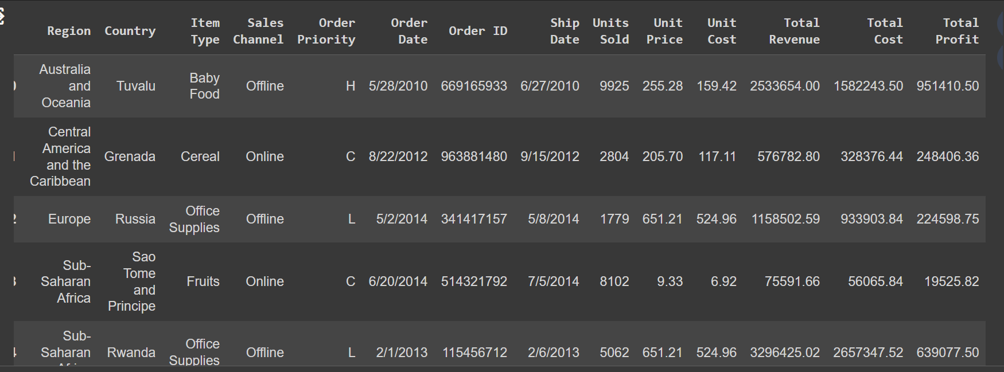
After uploading our data set in google collab by using pandas lib we can see how our data actually look like

Slide 5
These are some useful library for our data analysis
# importing important libraries - numpy, seaborn, pandas and matplotlib.
import numpy as np
import matplotlib.pyplot as plt
import seaborn as sns
import pandas as pd

Slide 6
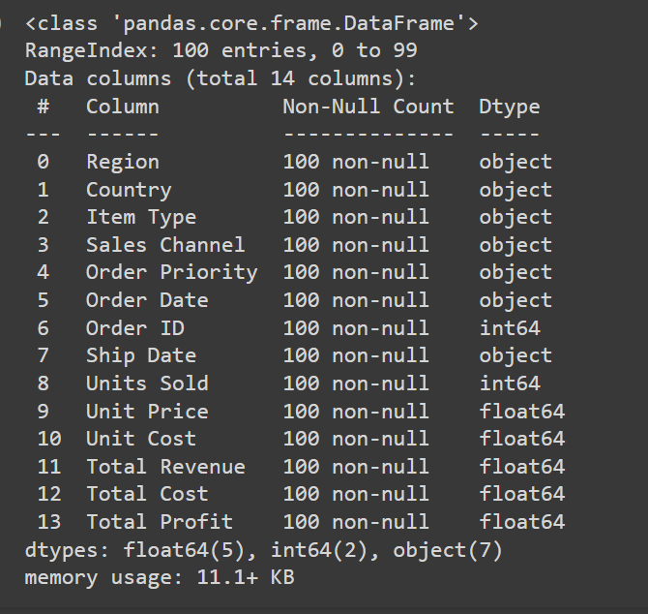
Data Summarisation
What is the shape of the data which means how many row and columns are present in the data it can be done by using pandas.shape
To get the information about the data that is the any null value present in the data or what type of value a colume hold

Slide 7
Data Cleaning Required
Drop the Duplicate Values
Drop unnecessary Columns
Fill missing Values
Change data or Time Columns in particular style
Apply some Standarization method to deal with over and underfitting problems
Apply Column Transformation if Required

Slide 8
Univariate Analysis
Data Analysis and Visualisation
The first step in doing any kind of EDA is identifying the distribution of important variables in EDA.
This helps us in finding important insights about the data.
We should look into the distribution of these specific columns:
Price Based Columns
Unit Price
Unit Cost
Total Revenue
Total Cost
Total Profit
Unit Profit
Time Based Columns
Order Date
Ship Date
Shipping duration
Ship day name
Location Based Columns
Region
Country
Other columns
Item type
Sales Channel
Units Sold

Slide 9
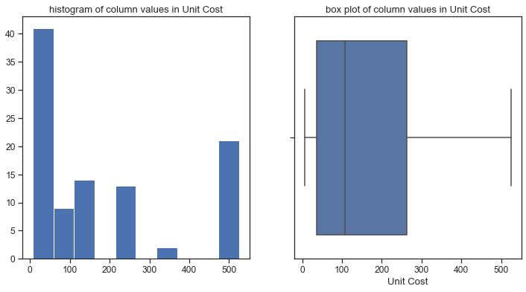
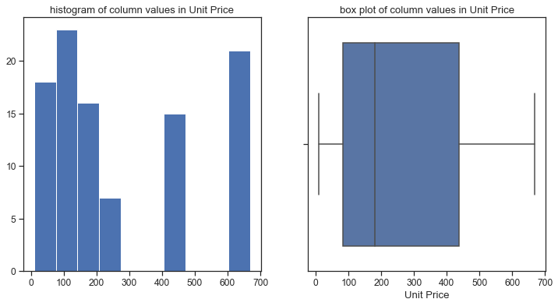
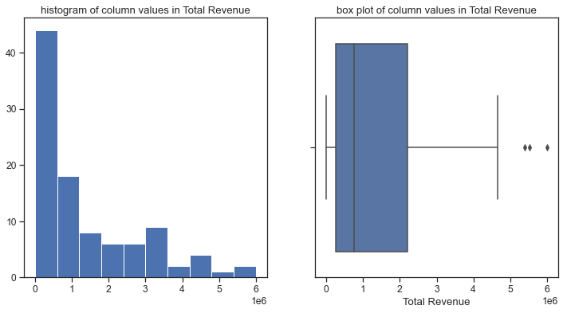
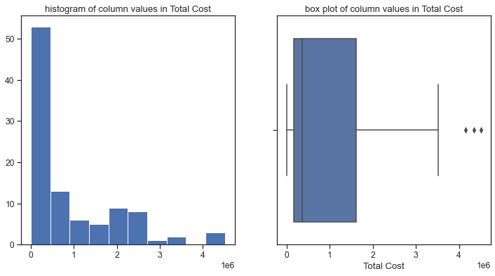
Plotting Histogram And BoxPlot for Contiguous Data

Slide 10
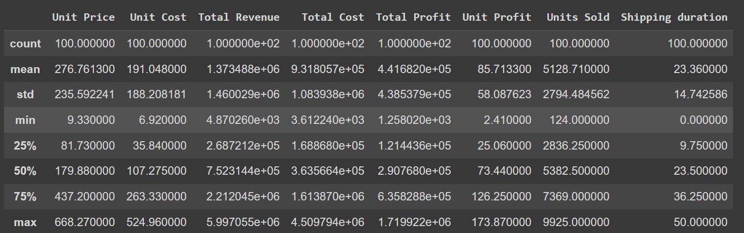
Describe Everyting with Contigious Data.

Slide 11
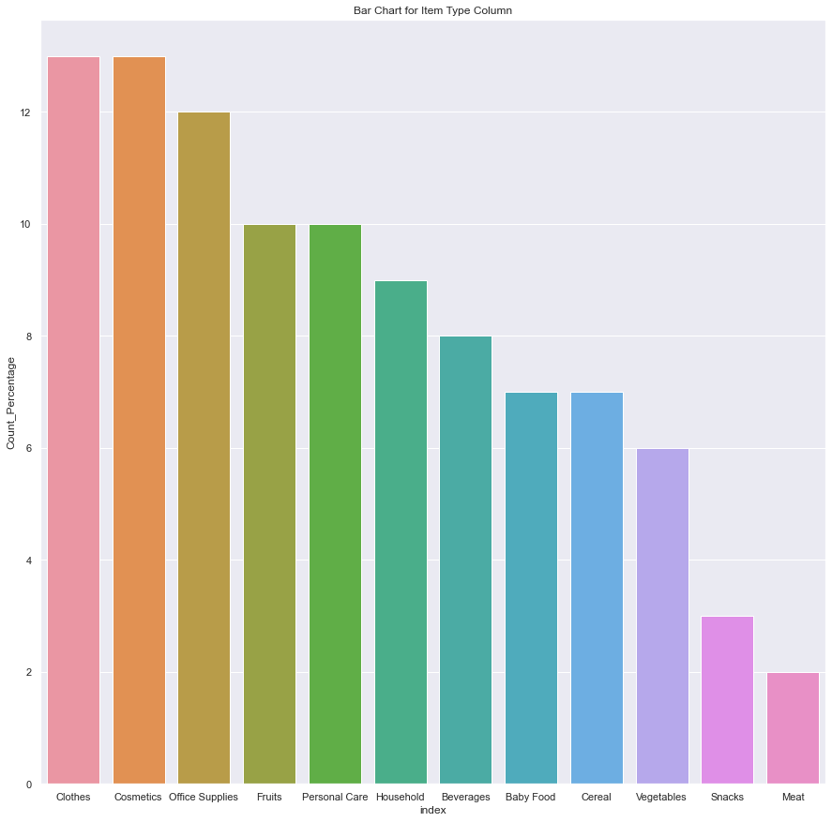
Here we are shown the count under each category but it is better to have count% for comparison and
From above bar chart we can see most of the item types are Clothes, Cosmetics and Office Supplies

Slide 12
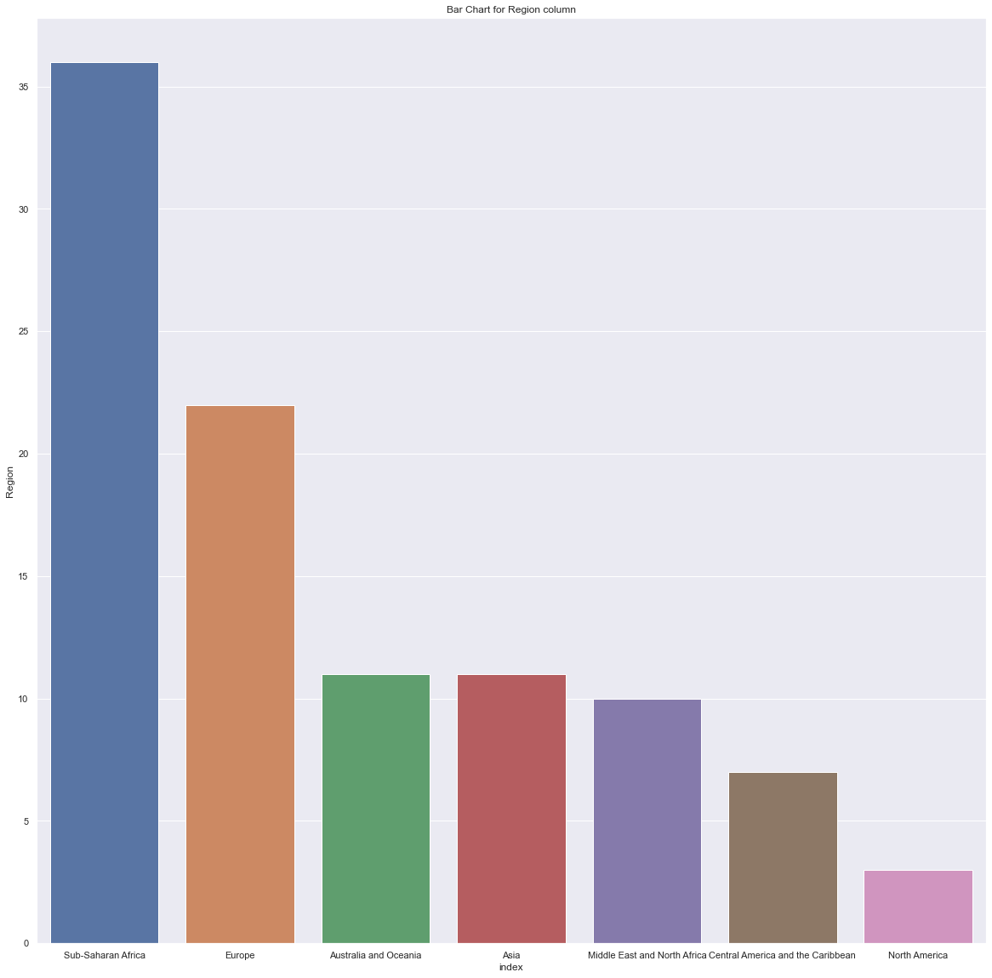
Moving on we will explore the distribution of location based features: * Region * Country
We can see the most common regions are Sub-Saharan Africa (37) and Europe (24).

Slide 13
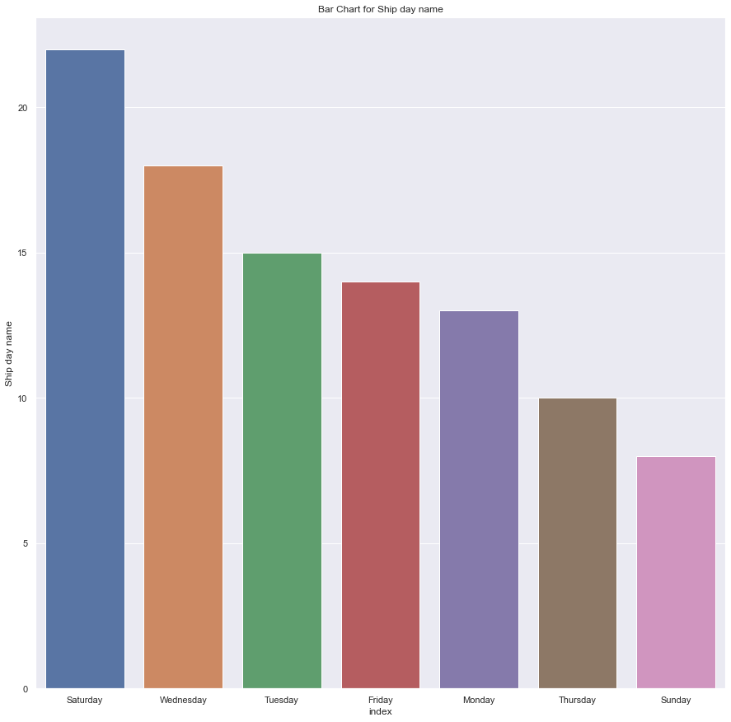
So we can say most of the shipping is happening on saturdays and wednesdays and least on Sundays
Now we are having two date fields i.e. Order Date and Ship Date
Here, we can find the required sales trend using just only the Order Date

Slide 14
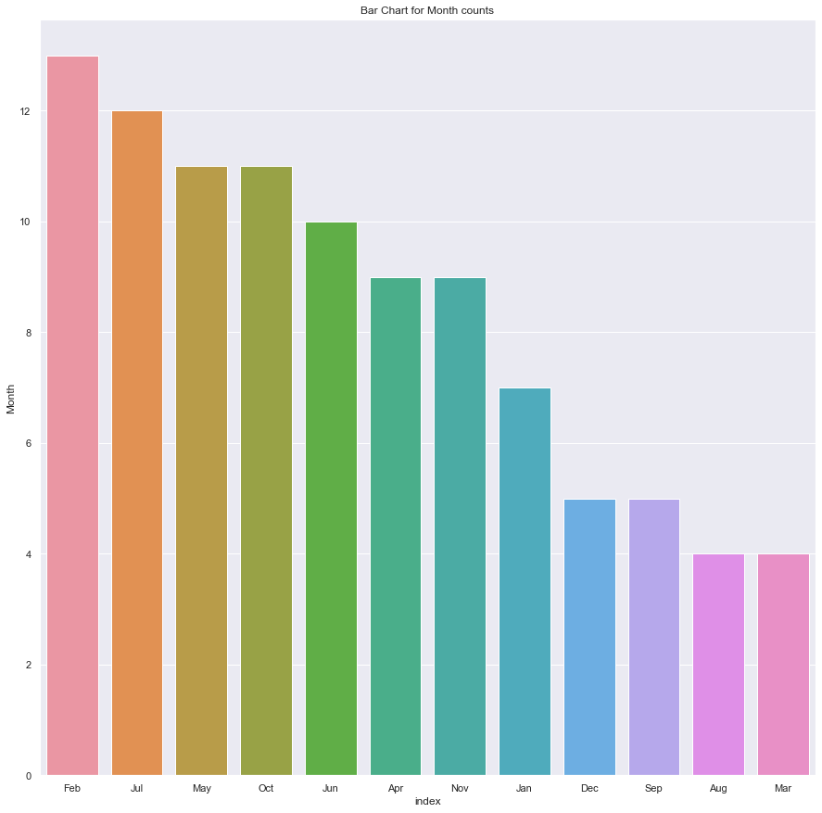
We need to find out Sales-trend -> month wise , year wise , yearly_month wise
Month Wise:

Slide 15
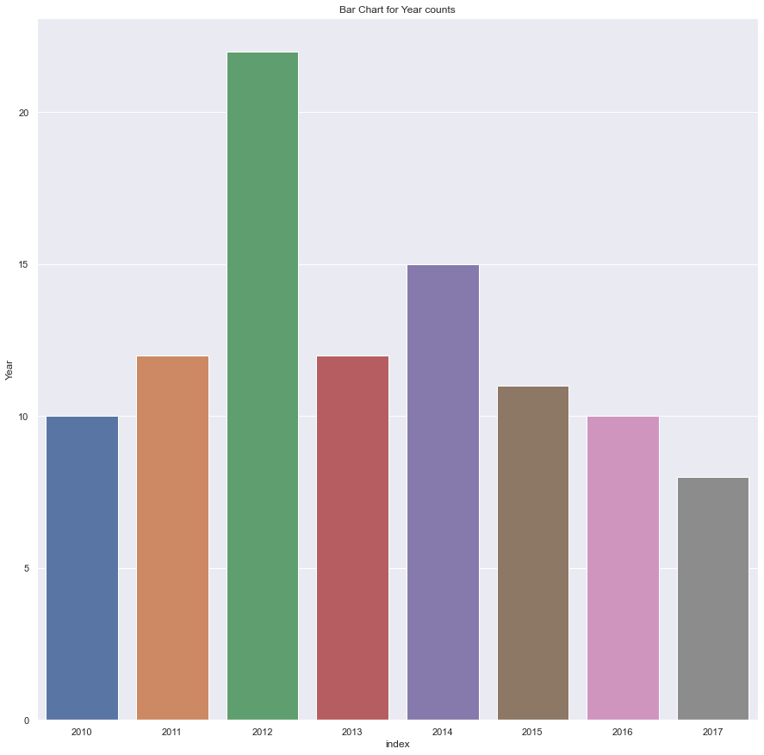
Year Wise:

Slide 16
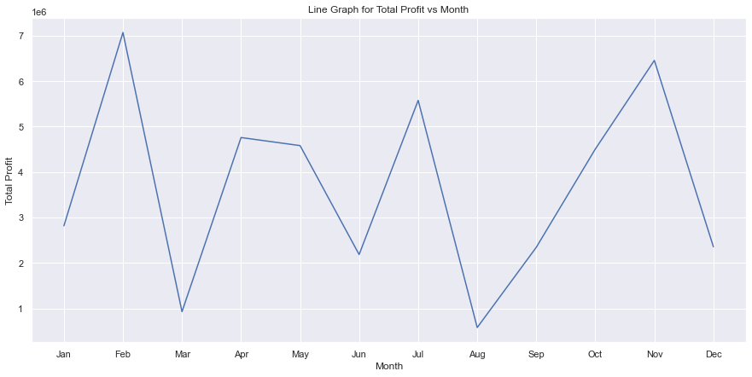
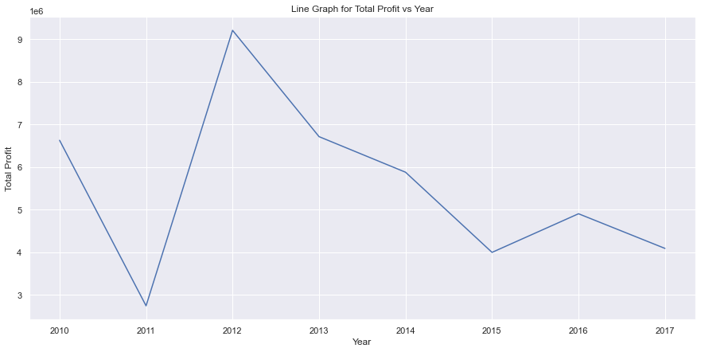
Total Profit Month and Year Wise

Slide 17
Thanking You

